Slide 1
Designing Slides:
Visual Companion Pieces for Presentations
Prepared for IUPUI Professional Writing Students
Working on Oral Presentation Companion Visuals
Fall 2017 / W231 Professional Writing
RELATED ASSIGNMENTS: Promoting a Client/ Project Proposal Presentations
Prepared by D.J. Oesch-Minor
Concepts and Wording Adapted from Hannah Haas’
“Using PowerPoint: Creating Effective Visual Aids for the W231 Oral Presentation”
Notes:
The opening slide should establish rhetorical context including: who, what, where, when (if needed, why and how).
Imagine you were presenting at a hotel that was hosting three conferences at the same time. Someone should be able to walk into your room, see your opening slide and know if she was in the right place, with the right conference, for the presentation she wants to see.

Slide 2
Designing Persuasive Visuals:
Context and Purpose
Purpose
  Visual Companion for Oral Presentation in W231?
  Visual Companion Piece for the Client to Share with Others?
  Read-Only Piece for Client or Other Audience?
  Other Purpose?
Audience
  Target Audience? Secondary Audience(s)? Gate Keeper?
Desired Outcome
Notes:
Some visuals have different purposes. Know yours. A visual shared online only will usually have more complete ideas while a visual for a presentation will be very concise—key ideas only.

Slide 3



Select a Technology
Computer-Based Technologies
  Reliable Save to Memory Stick
  Don’t Need Internet Access
Cloud-Based
Technologies
  Shared Document with Internet Access
  Auto Save
  PowToon
  Prezi
  Teams Can Work In-Real Time Together
  Google Slides
Google Slides
Notes:
Notice the visuals here. There is a consistency. What is it? (Each is a company logo)

Slide 4


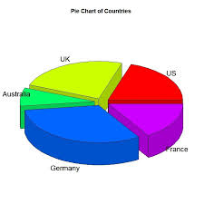
Select a Design
With Audience in Mind:
Slide Design
Color Choices
Recurring Item/s
With Purpose in Mind:
HEADING Styles
Caps? Bold?
Art and Graphs
Realist?
From Report?
From Website?
Notes:
Critique this series of visuals. (They do not go together well because one is a photo (realist), one is logo-art based and the other is an Excel chart with bad colors. Be sure there’s unity among visuals.

Slide 5

Building Visuals for
Oral Presentations
Ludwig Mies van der Rohe,
German born architect and designer:
“Less is More”

Slide 6
Choosing a Design Template
Consider Visual Accessibility
  Readability
  Presentation Room Lighting
  Audience Appropriateness
Avoid Distracting Templates
  With Dark Backgrounds
  With Busy Backgrounds
  Unrelated or inappropriate graphics

Slide 7
Choosing a Color Scheme
Enhance Readability
  Audience must be able to see a contrast of background and text to focus on the content
  Clean designs are most readable
Reflect the Client’s Colors
  Visit the client’s website or promotional materials
  Match their color scheme as closely as possible

Slide 8
Choosing a Slide Layout
Select Slide Layouts
  That best suit your purpose for the individual slide
  That provide text window to simplify your typing
  That continue continuity for the presentation
  That enhance readability
Select a Blank Slide
  When the design options do not meet your needs, pick a blank slide
Copy and Paste Your Favorite Slides
  Then, type over the previous materials to save time

Slide 9
Using Bulleted Lists
Use Bulleted Lists
  Keep bulleted points short
  Use parallel words to open each item in a list
    Verbs
    Nouns
    Repeated Terms
Do not try to use bulleted points to cram entire sentences or quotes into bulleted lists. Long bullets are hard to read and will not enhance your presentation. Instead, share commentary orally and use short lists as reference points for the audience.
Notes:
Emphasize that the long sentence is an example of a bad slide moment. Short, parallel lists work better.

Slide 10
Using Sound Effects
Use Sound Sparingly
Anticipate Technological Challenges
  Arrive early to play the sounds and set volume levels
  When the design options do not meet your needs, pick a blank slide
Do Not Rely on Sound
Avoid Cute or Unprofessional Sounds

Slide 11

Using Images
Use Images to Illustrate Concepts
Be Consistent with Image Style
  Go with one type of image or artwork to build consistency
  Consult with peers when creating a visual together
Avoid Cute Clip Art or Unprofessional Art
  Keep the audience in mind—
  there are always exceptions
Notes:
The dog slide here is familiar to Oesch-Minor W231 students because a team of student presenters made a visual for me to share with other W231 classes about how challenging the Recommendation Report can feel, but how rewarding it is. This presentation ends with the “dog tired” moment. So, even though it might seem out of place in this visual presentation, it connects with my target audience who will remember it from a previous PowerPoint.

Slide 12
Giving Credit
Where Credit is Due
Use APA Format to Cite Borrowed Data
Provide Access Data for Visuals Unless They Are Team Originals
  Identify Survey Monkey if you use their charts
  Identify URL for other charts/photos/art
An APA Formatted Reference Page is Ideal

Slide 13
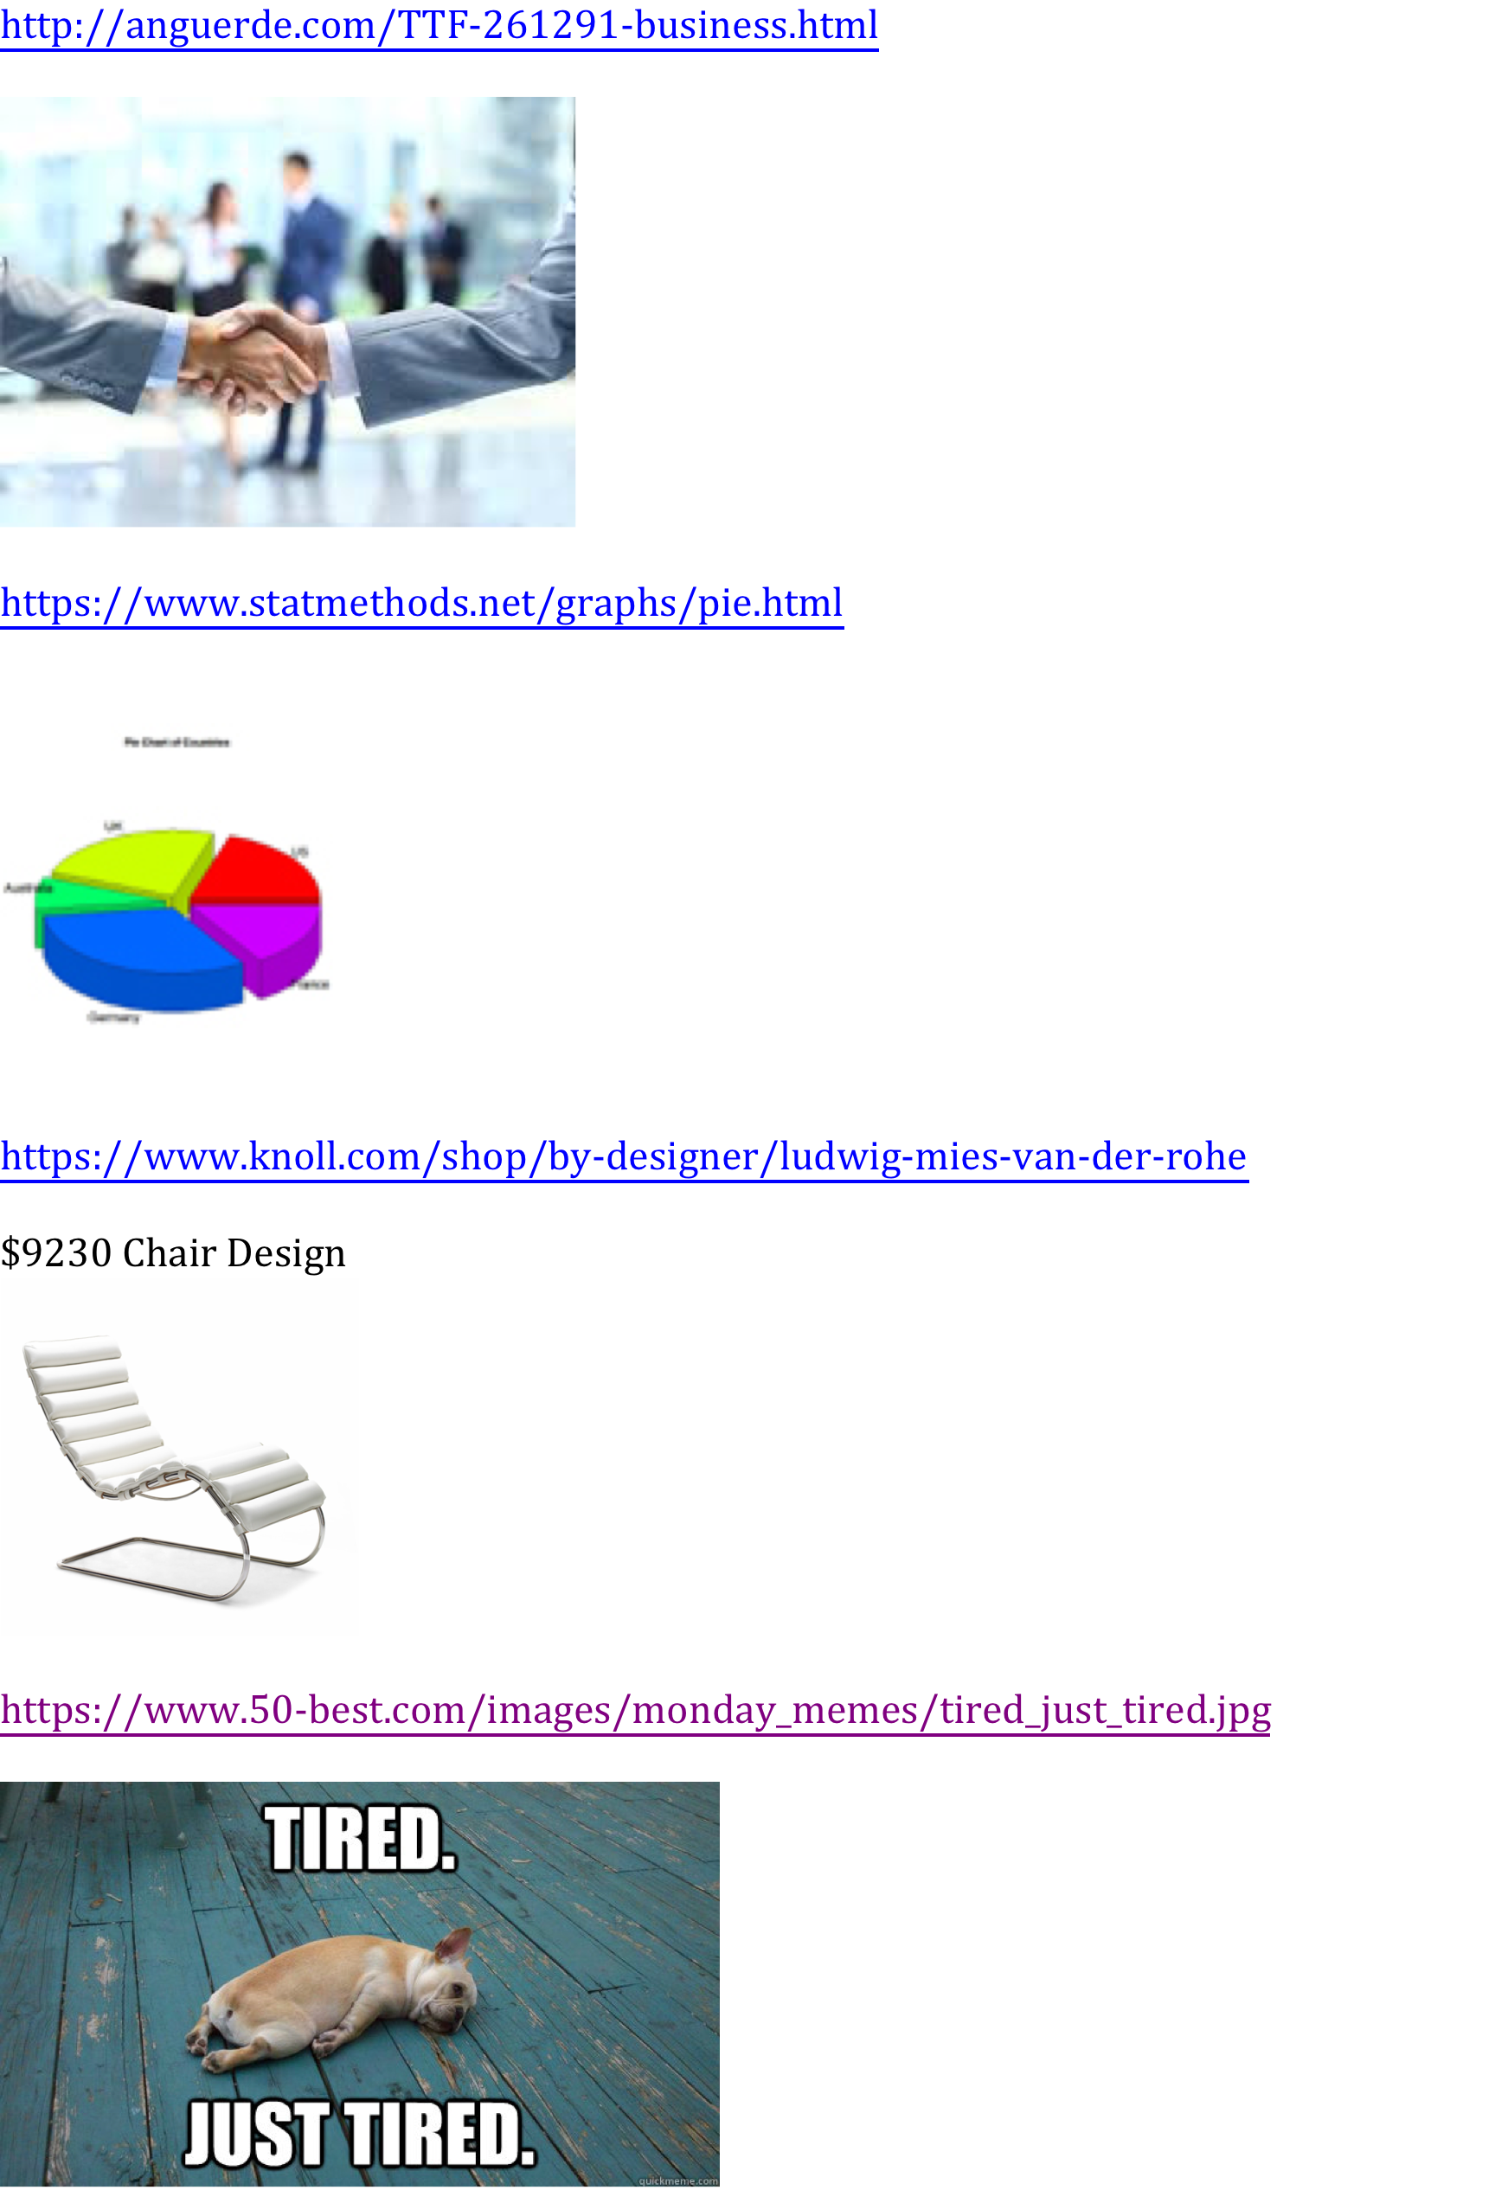
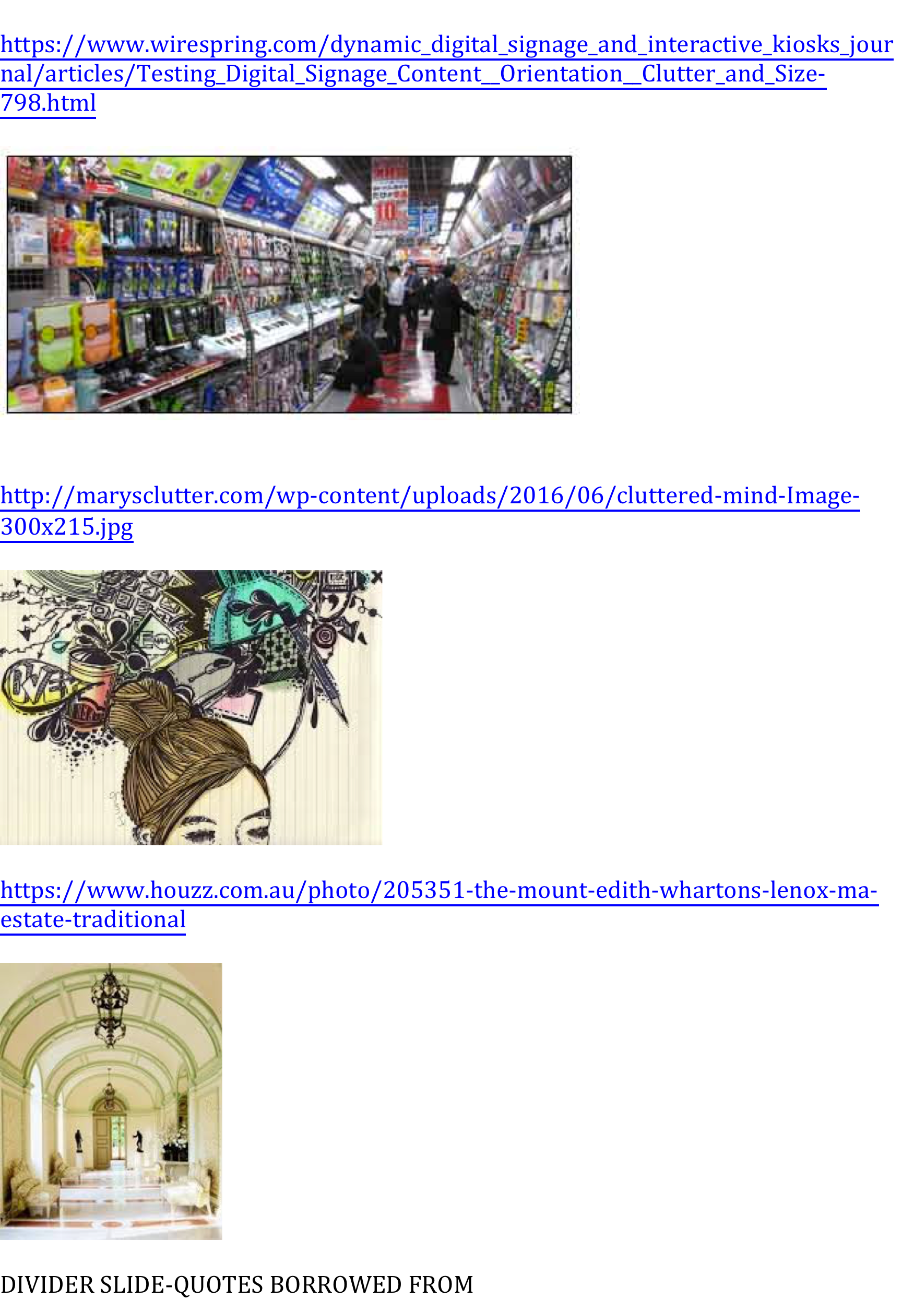
Some Attribution is Better Than None At All

Slide 14
Building Visuals:
Cautions
Leonardo da Vinci,
Italian inventor, sculptor and
possibly the greatest painter of all time:
“Simplicity is the ultimate form of sophistication”

Slide 15


Cautions for Visual Designers
Google Slides, PowerPoint and other tools “help build colorful, eye-catching presentations; however, flashy colors, sounds and confusing graphics can detract from your purpose.
The visual should compliment the presentation, not dominate it.”
(Hass, 2015)

Slide 16
Expect Technical Difficulties
“If something can go wrong,
create a work around.”
--Debbie Oesch-Minor

Slide 17


Technology
Is Not Reliable
Open Files on the Computer You’ll Use in the Room You’ll Be Talking In
  If You have something on a Memory Stick, keep it in a cloud too
  If you have something in c cloud, try to put it on a memory stick too (in case the internet is down)
Test the Projection System
Test Sound (as needed)
Make a Trial Run Through ALL of Your Visual
Notes:
Notice the visuals here. There is a consistency. What is it? (Each is a company logo)

Slide 18

Step Back:
Look at your visual from several spots in the room

Slide 19

Presentation:
Finish Strong
Edgar Degas, one of the French
founders of Impressionism, known for his dance paintings:
“Art is not what you see, but what you make the others see.”

Slide 20
Keys to a Successful Presentation: Closing
Have a Slide to Encourage Questions
  Provide a sample question just in case the audience can’t think of one
Be Patient: Allow Time for the Audience to Come Up with Questions
Be Willing to Admit You Don’t Know an Answer
Have a “The End” Slide After the Q&A
Have an Exit Plan
  Who closes the visual and gets the memory stick?
  Who tidies up if there is a mess?
  Who thanks the client for coming?

Slide 21

Edith Wharton,
American Pulitzer Prize winning novelist,
short story writer and designer:
“True originality consists not in new manner but in new vision.”
Look for inspiration everywhere and put your own spin on it.
--Susan Newberry (22 Nov. 2015)

Slide 22
Questions about your project proposal presentation?
What?
When?
How?

Slide 23
Reference Page
CONTENT AND QUOTES:
Hass, Hannah. Creating effective visual aids for the
W231 oral presentation. PowerPoint. IUPUI
Canvas file:///Users/djoeschm/Downloads/
Hanna's%20PPP%20on%20PP%20(2).pdf
Newberry, Susan. (22 Nov 2015) My ten favorite design
quotes. The BLOG. Huffington Post. https://
www.huffingtonpost.com/susan-newberry/my-f
avorite-design-quotes_b_8353126.html

Slide 24
Images and URLs

Slide 25


